Slide 1
DSS Stakeholder's Workshop - CS7 DSS Prototype
Kristian Nielsen (WEMC) – 12 May 2026

Slide 2


What is CS7 about
We build consistent, country-level time series for Europe showing how climate change may affect electricity demand and renewable generation, including wind, solar, hydro, and demand.
These data are produced across multiple climate models, emissions scenarios, and future periods, so energy planners can test how robust the European power system is under different climate futures.
In short: CS7 turns climate projections into usable inputs for energy-system planning and stress-testing usable for risk assessment on regional scale.
CMIP6 climate projections
C3S Energy indicators
Electricity system optimization and simulation tool
Marginal cost, hours of non-met energy, slack....

Slide 3
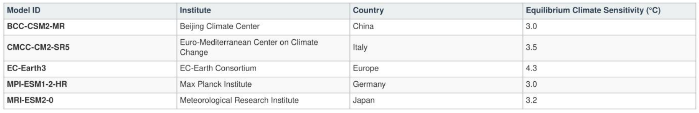
The data used
Capturing natural variability and uncertainty.
Scenarios: CMIP6 SSP3-7.0 and SSP5-8.5 emission pathways
The ensemble: 21-year window centered on 2030 (2020-2040, +-10 years) and 2050 from each GCM.
Total Scenarios: With 5 Global Climate Models (GCMs) this provides a statistical robust sample of 105 ensemble members.

Slide 4
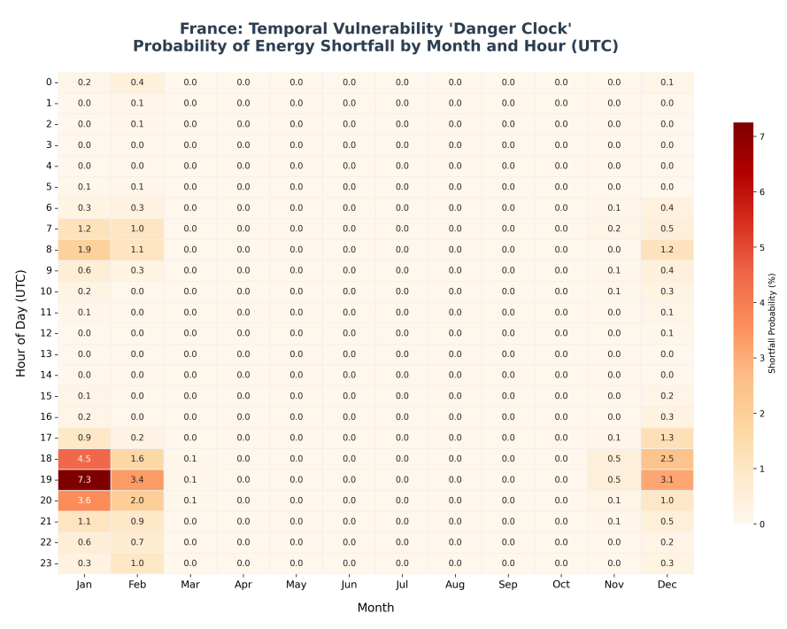
Results from plan4res
What this shows: The frequency of energy shortfalls categorized by hour of day.
The Conclusion: 90% of risk is concentrated between 17:00 and 21:00 UTC. This is the window where peak heating demand collides with sunset and low wind.

Slide 5
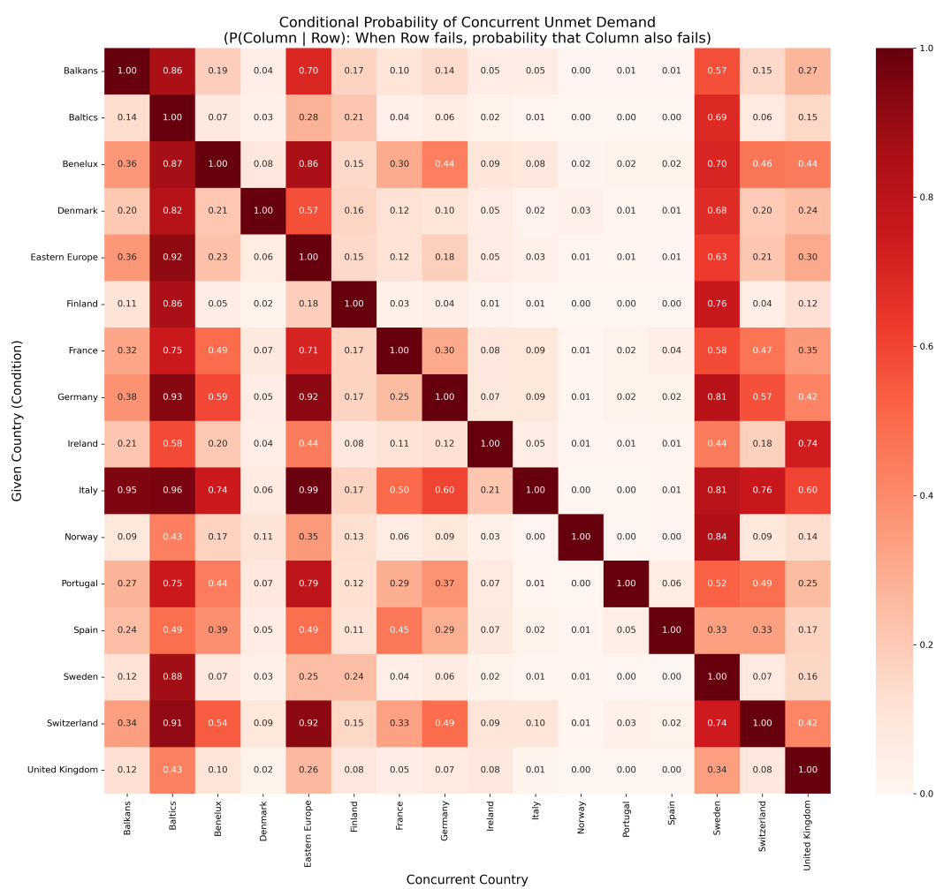
Results from plan4res
Finding: When one country experiences unmet demand, the probability that neighbors are simultaneously stressed is high.
The Critical Limit: In 73% of all shortfall hours, at least one immediate neighbor is also unable to meet its own demand, limiting the import solution.

Slide 6
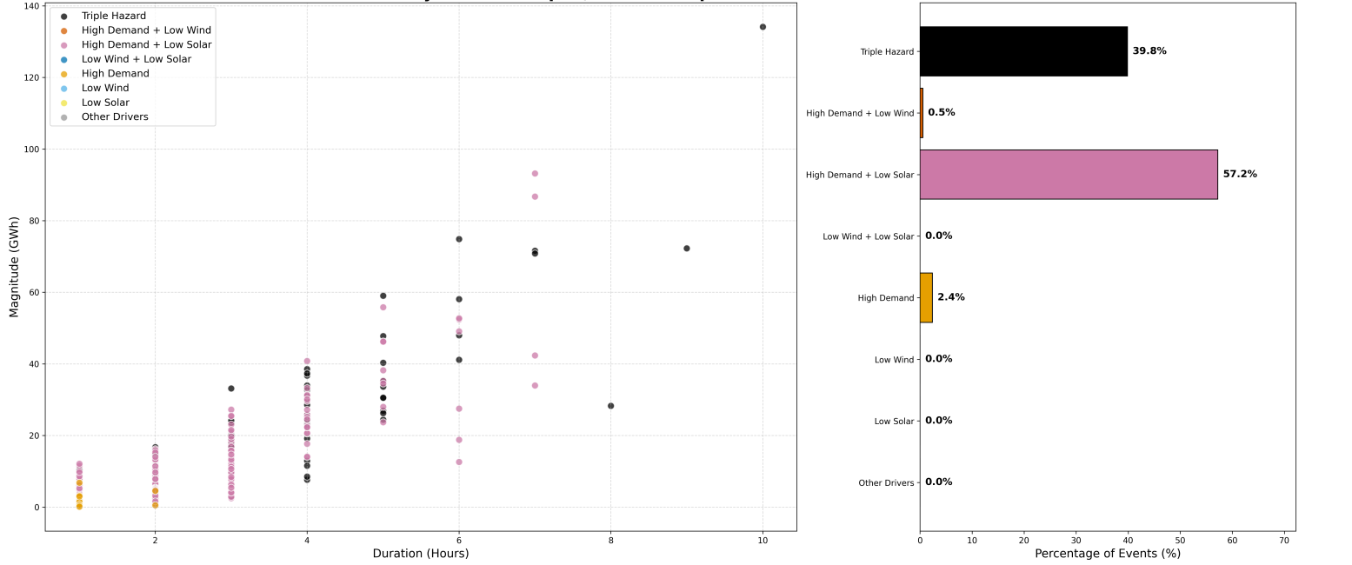
Results from plan4res
What this shows: Many smaller shortfalls are driven by Low Solar or Low Wind acting independently during more typical demand conditions.
The Conclusion: Day-to-day stability is often challenged by single-variable variability, but the most damaging events are the compounded ones.
France Shortfall Drivers (Sensibility: Demand >p67, Weather < p33)

Slide 7
The CS7 DSS
Let us see the tool...!

Slide 8
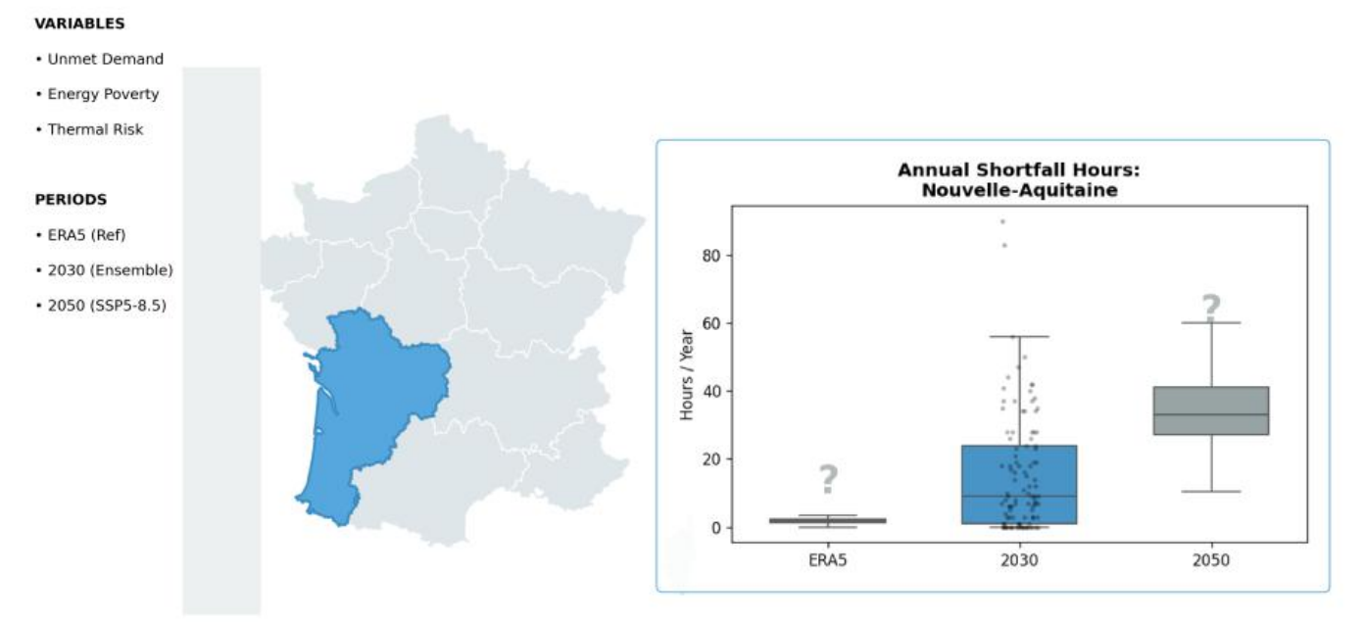
Next implementations in the DSS.
Implementation of hazard indicators from plan4res outputs such as annual shortfall hours, hours on last source, marginal cost...

Slide 9
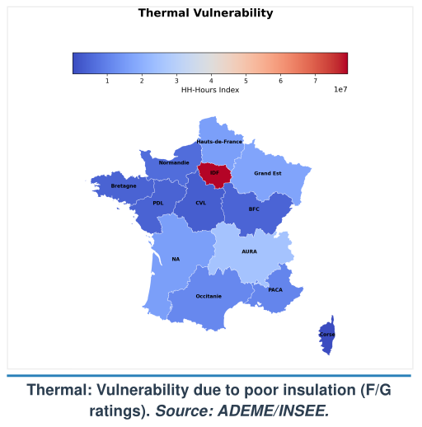
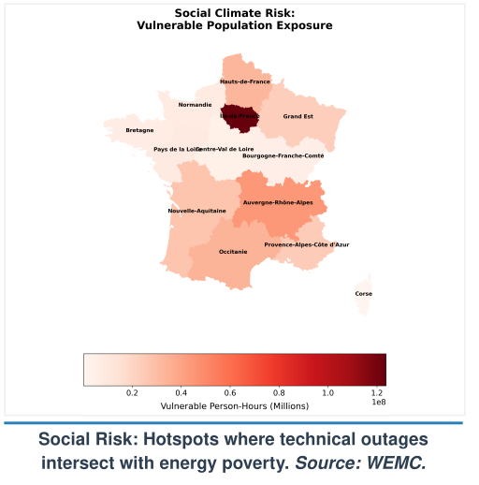
Next implementations in the DSS.
Implementation of hazard indicators from plan4res outputs such as annual shortfall hours, hours on last source, marginal cost...

Slide 10
Thank you!

Slide 11
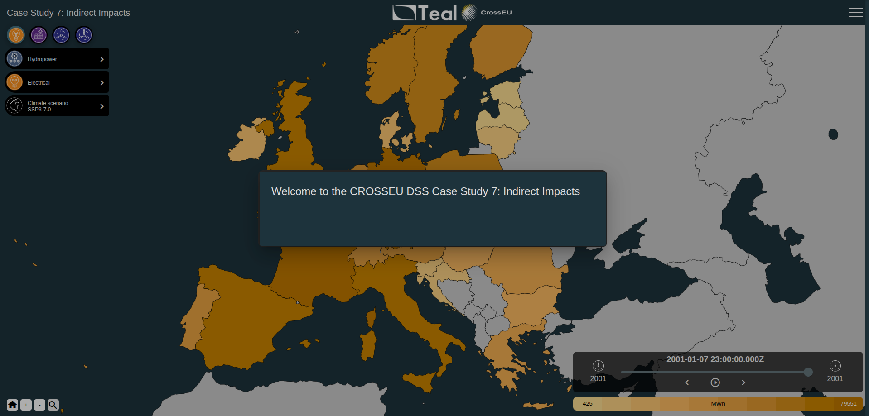

Slide 12
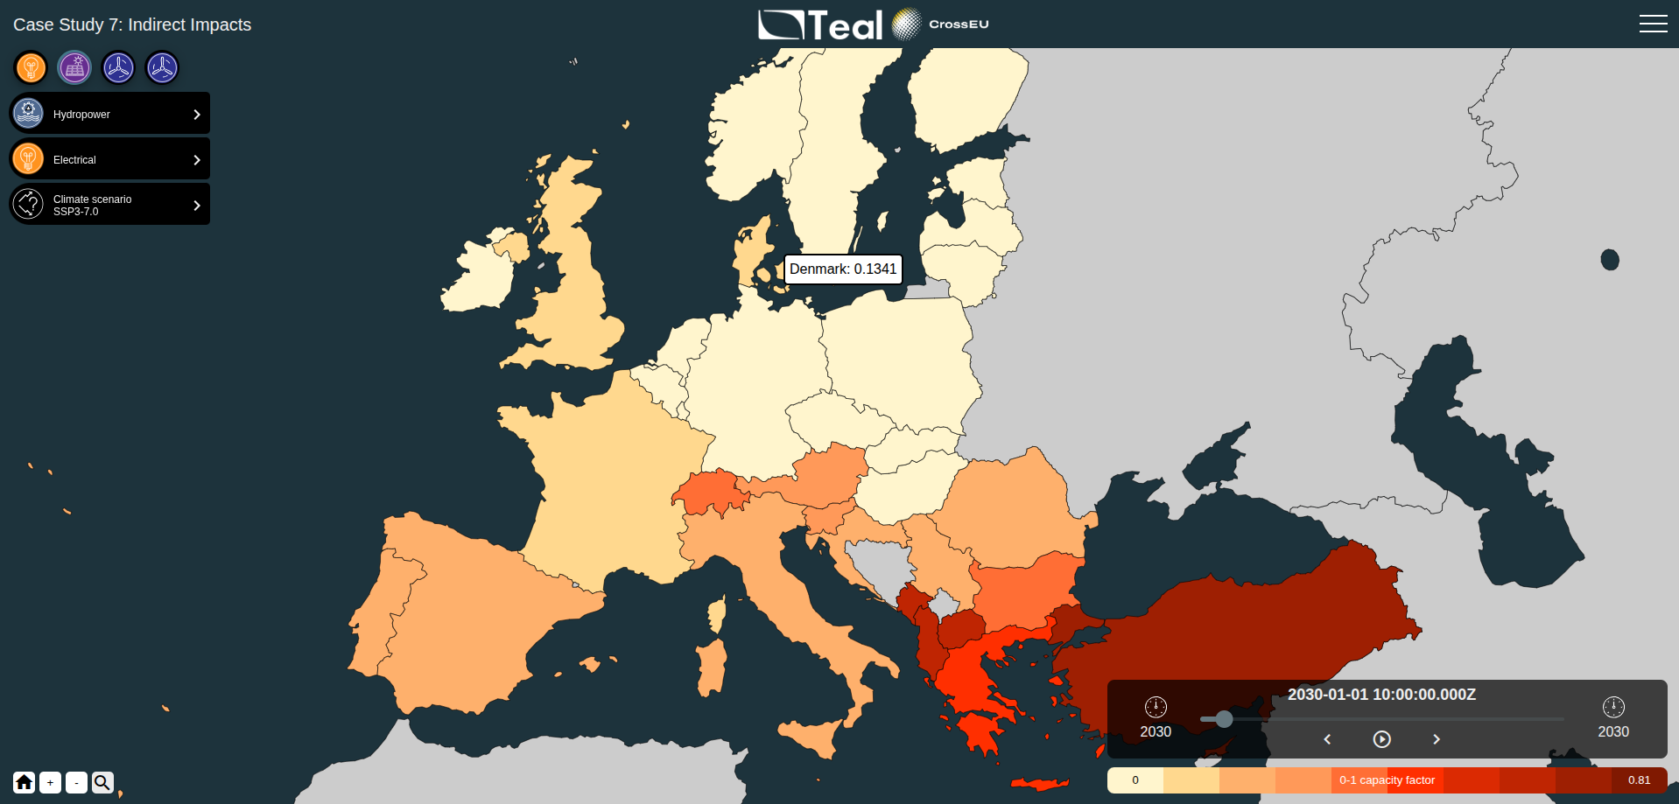

Slide 13
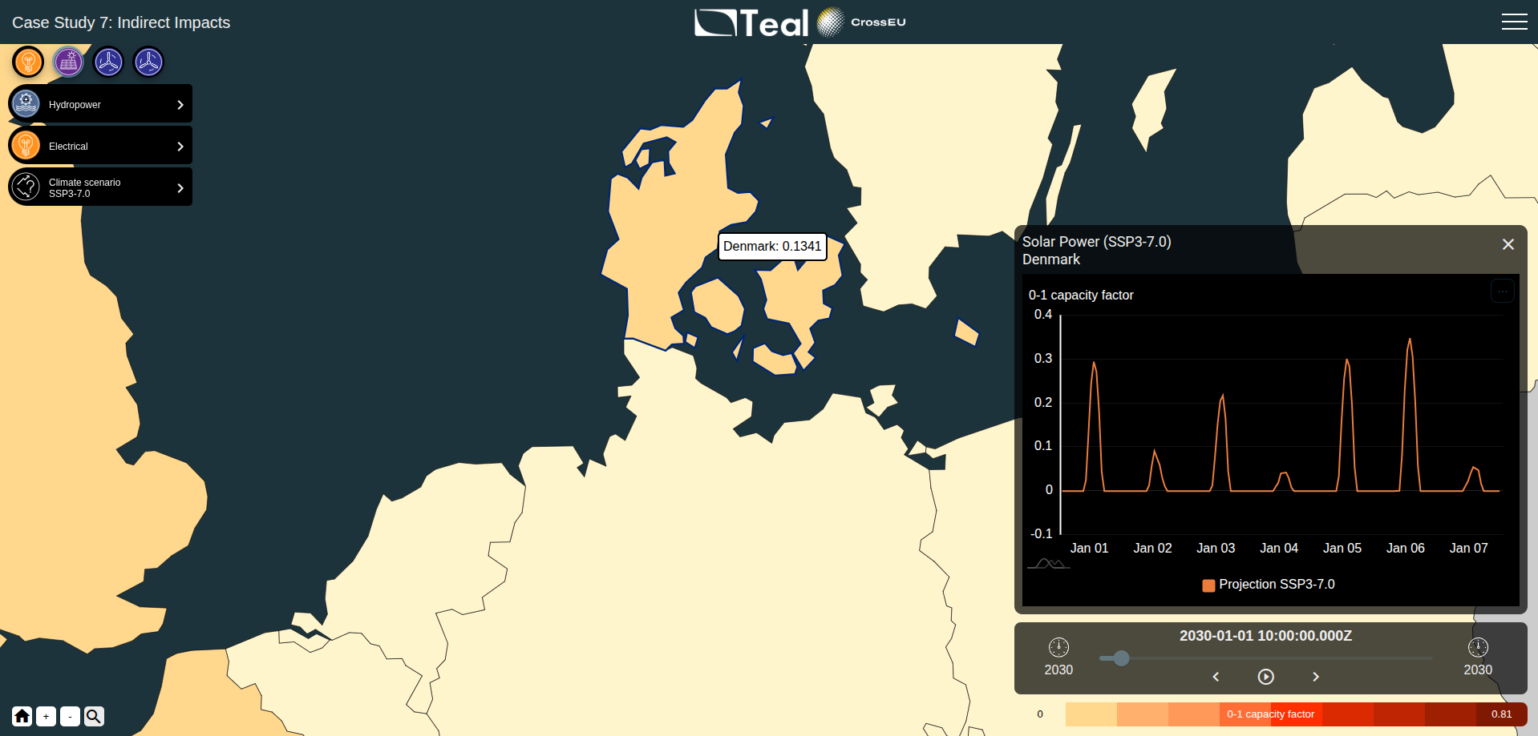

Slide 14
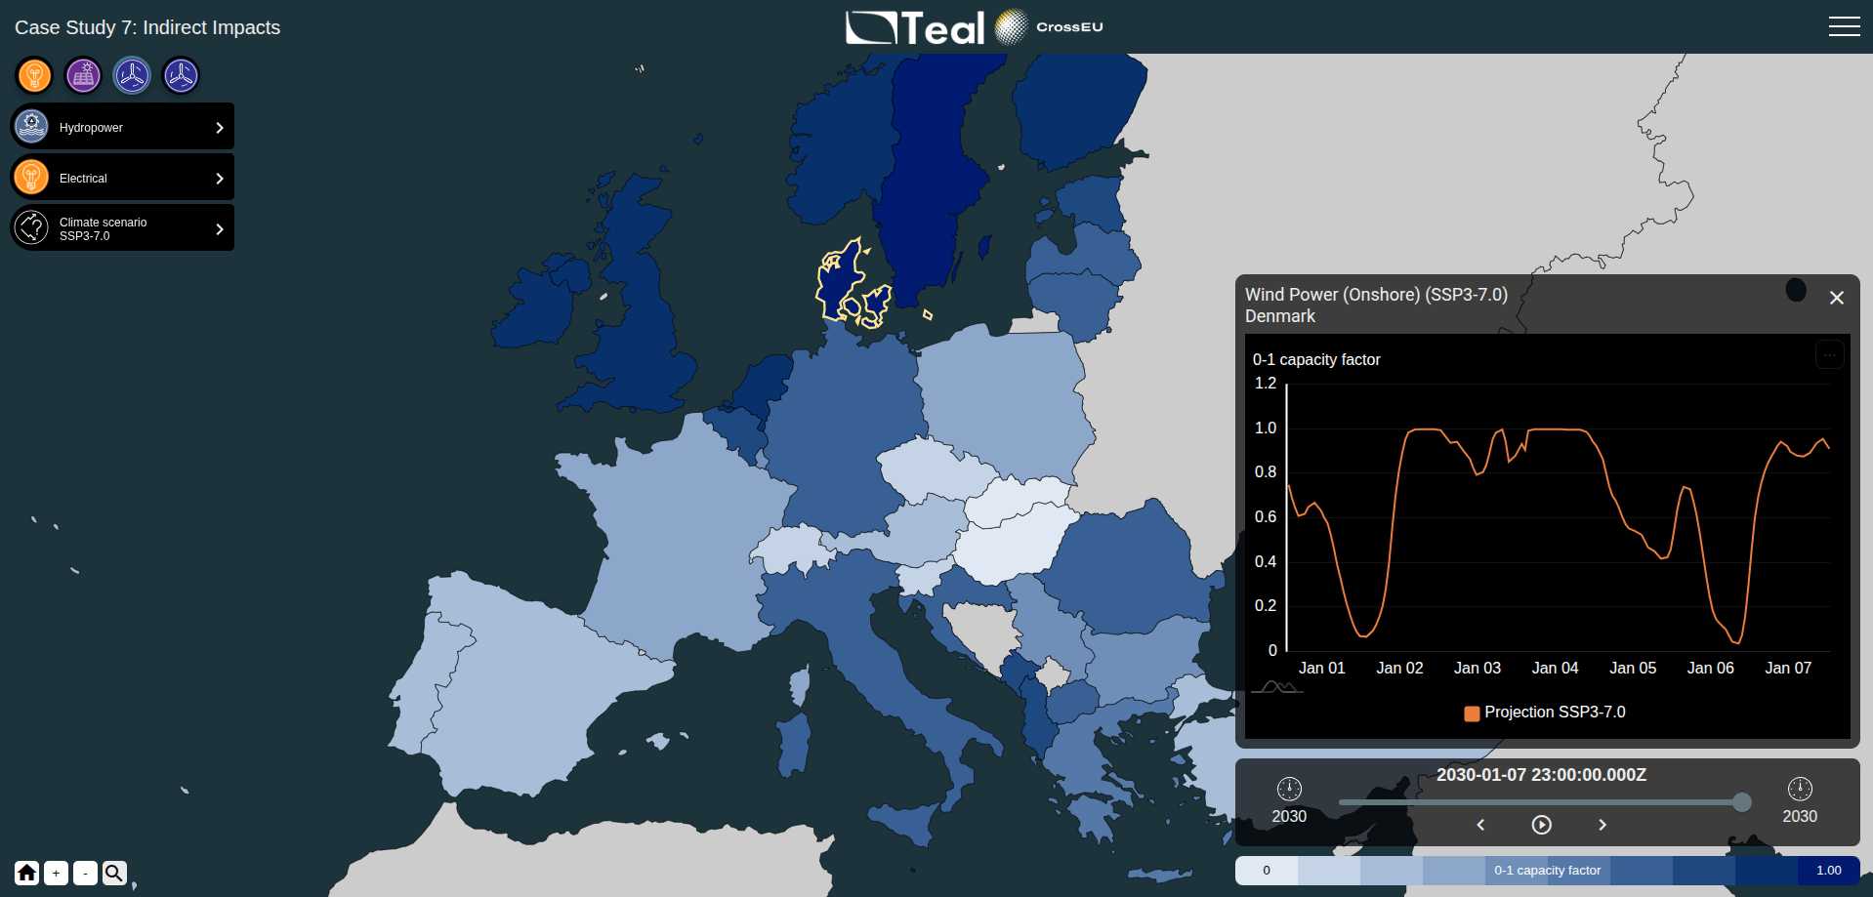

Slide 15
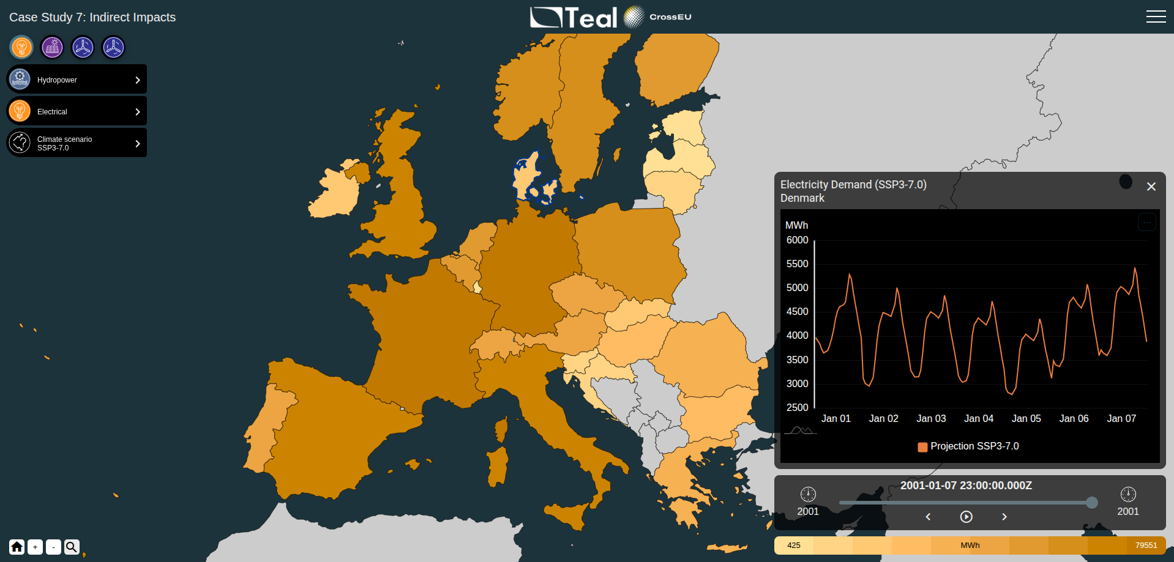

Slide 16
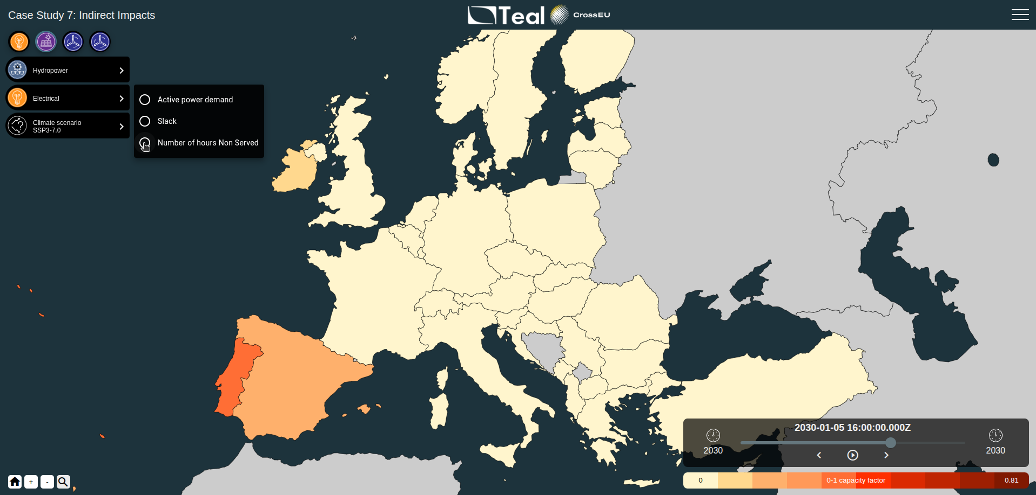

Slide 17
Next implementations in the DSS.
Implementation of hazard indicators from plan4res outputs such as annual shortfall hours, hours on last source, marginal cost...

Slide 18
Next implementations in the DSS.
Implementation of hazard indicators from plan4res outputs such as annual shortfall hours, hours on last source, marginal cost...

